Slide 1
China technology and reacreation

Slide 2
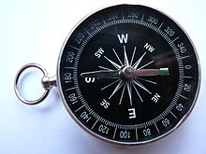
Technology
Compass
Used in navigation, and map making
Very important to the transportation industry, as well as the shipping and airplane industry.

Slide 3
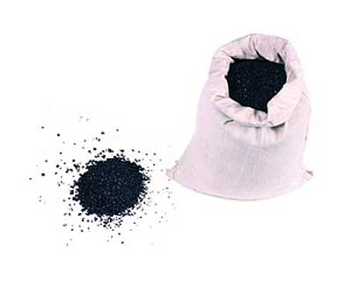
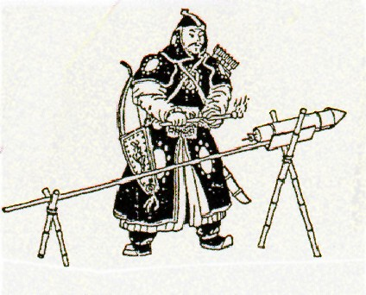
technology
Gunpowder
Used in guns and explosives
Gunpowder was used Ancient china
Used in military and such things like fireworks

Slide 4
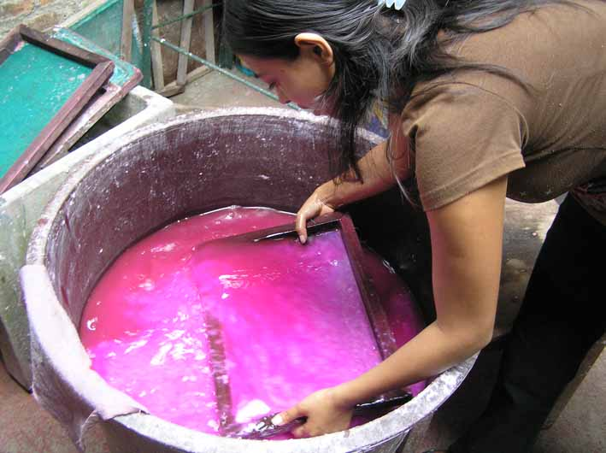
technology
Paper
Paper is used for a lot of things we take for granted todayfor example: envelops, cards, and just regular writing paper
China invented paper

Slide 5
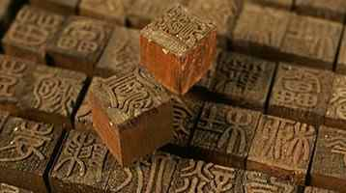
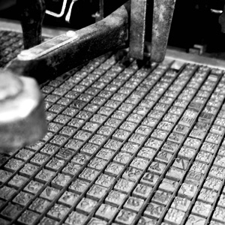
technology
Printing
China first printed on paper with wood blocks that were ingraved with what wanted to be printed
Modern printer today is based of the wood block idea

Slide 6
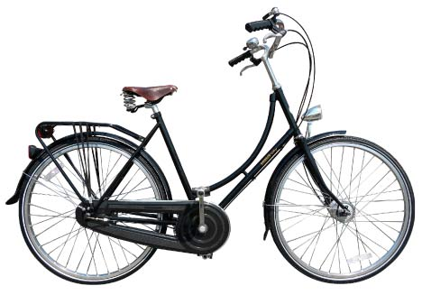
recreation
Different areas in china have different activities for children and adults.
Most areas in china inculde biking as a activity
There are a lot of traditional activities

Slide 7
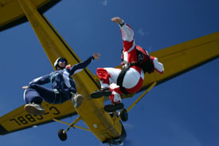
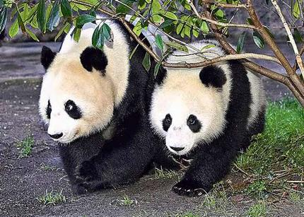
recreation
In China the activities they have over there are the same as we have over here depending on your location some like parachuting, going to zoos, and a marina with dolphines

Slide 8
biblegraphy
Wiki
Google images
http://www.china-hotels.ws/activities.htm
http://www.hoteltravel.com/china/guides/activities_sports.htm

